Slide 1
Creating Interactive Webpages to Highlight Student Success
Benjamin Spanbock
UCB College Writing Programs, 2015

Slide 2
Part 1: Blending Instruction by Creating Course Pages
“Blended learning is the thoughtful fusion of face-to-face and online learning experiences. The basic principle is that face-to-face oral communication and online written communication are optimally integrated such that the strengths of each are blended into a unique learning experience congruent with the context and intended educational purpose.”
Garrison and Vaughn, Blended Learning in Higher Education
“The magic is in the mix”
Elliott Masie, The Blended Learning Imperative
Ben Spanbock. UCB College Writing Programs, 2015

Slide 3
Part 1: Blending Instruction by Creating Course Pages
“Blended learning is the thoughtful fusion of face-to-face and online learning experiences. The basic principle is that face-to-face oral communication and online written communication are optimally integrated such that the strengths of each are blended into a unique learning experience congruent with the context and intended educational purpose.”
Garrison and Vaughn, Blended Learning in Higher Education
“The magic is in the mix”
Elliott Masie, The Blended Learning Imperative
Ben Spanbock. UCB College Writing Programs, 2015

Slide 4
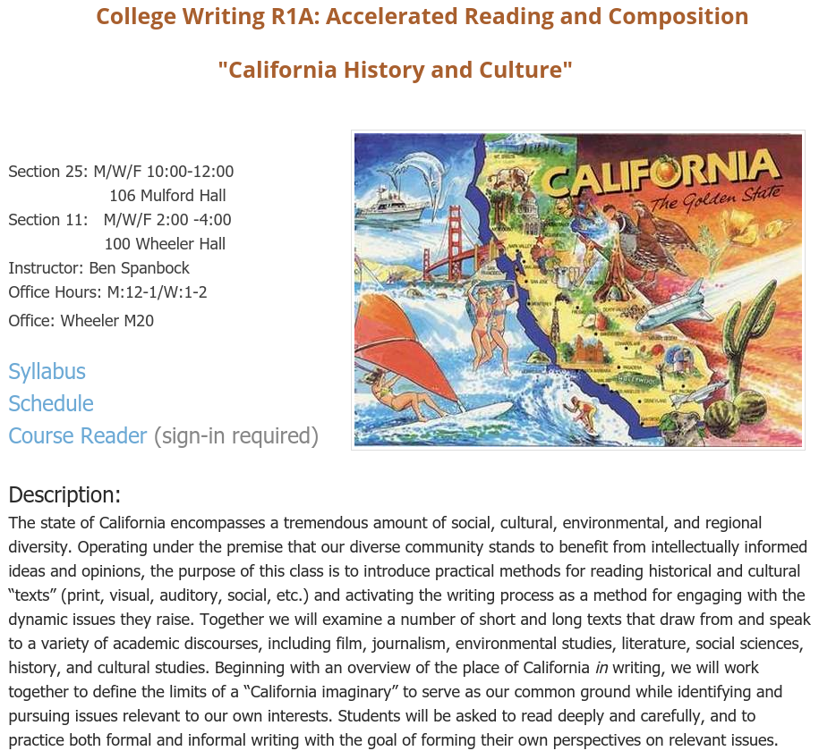
Part 1: Blending Instruction by Creating Course Pages
www.benspanbock.net/californiacourse
Ben Spanbock. UCB College Writing Programs, 2015

Slide 5
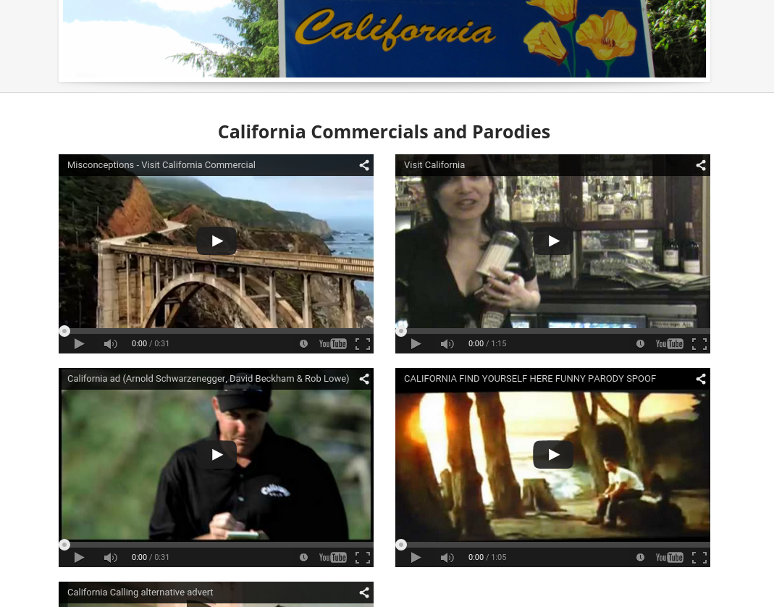
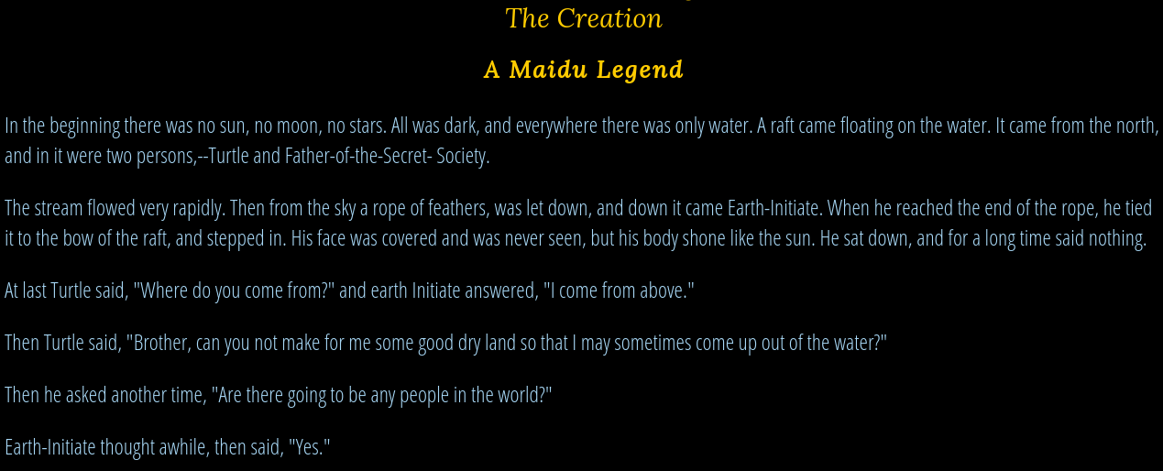
Types of Content Made Available
Video:
Map/Image:
Website/Text:

Slide 6
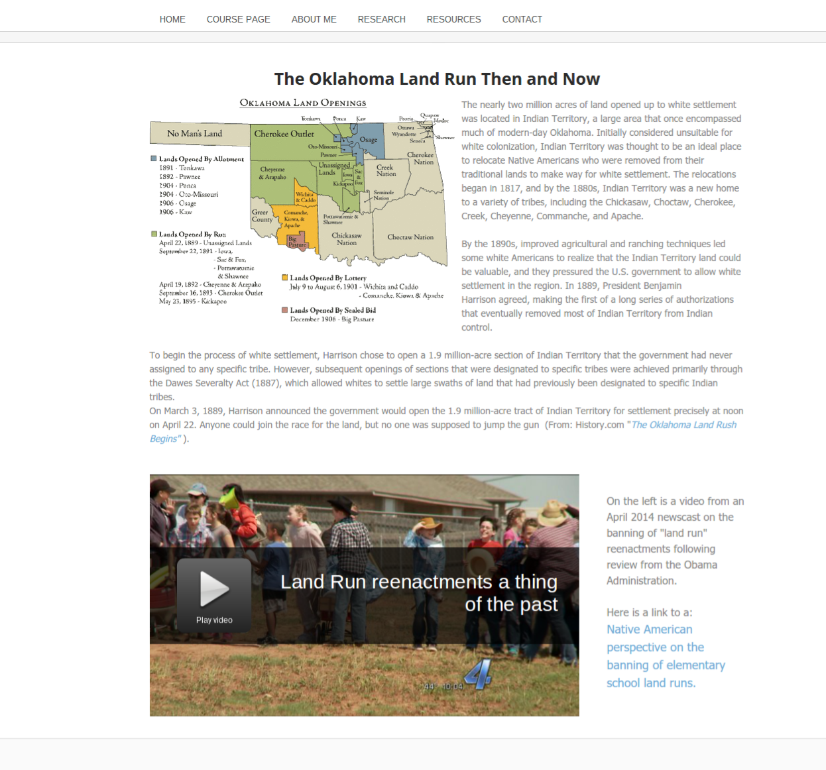
Project Pages
online spaces for housing course content
Ben Spanbock. UCB College Writing Programs, 2015

Slide 7
Part 1: Blending Instruction by Creating Course Sites
Primary functions of course/project pages:
Make curated sets of materials easily available to my students
Diversify the mediums composing that curated set
Promote continued engagement with course materials in and out of class
Make course “culturally relevant”
Emphasize project-based learning by dividing materials into cohesive units
Ben Spanbock. UCB College Writing Programs, 2015

Slide 8
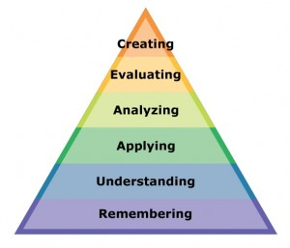
Part 1: Blending Instruction by Creating Course Sites
Lessons from the Flipped Classroom Model:
“Students gain first exposure to new material outside of class, usually via reading or lecture videos, and then use class time to do the harder work of assimilating that knowledge, perhaps through problem-solving, discussion, or debates...this means that students are doing the lower levels of cognitive work (gaining knowledge and comprehension) outside of class, and focusing on the higher forms of cognitive work
Cynthia Brame, Flipping the Classroom
(application, analysis, synthesis, and/or evaluation) in class, where they have the support of their peers and instructor.”
Bloom’s taxonomy
Ben Spanbock. UCB College Writing Programs, 2015

Slide 9
Part 1: Blending Instruction by Creating Course Sites
Lessons from the Flipped Classroom Model:
“Students gain first exposure to new material outside of class, usually via reading or lecture videos, and then use class time to do the harder work of assimilating that knowledge, perhaps through problem-solving, discussion, or debates...this means that students are doing the lower levels of cognitive work (gaining knowledge and comprehension) outside of class, and focusing on the higher forms of cognitive work
Cynthia Brame, Flipping the Classroom
(application, analysis, synthesis, and/or evaluation) in class, where they have the support of their peers and instructor.”
Bloom’s taxonomy
Ben Spanbock. UCB College Writing Programs, 2015

Slide 10
The Flipped Classroom Model and Active Learning
Active learning techniques are privileged as conducive to “higher order” thinking and learning ---and therefore can be directly linked to student success---
Active learning is something that takes place in the classroom
Online instruction thus necessarily becomes the place of passive, lower order learning
Ben Spanbock. UCB College Writing Programs, 2015

Slide 11
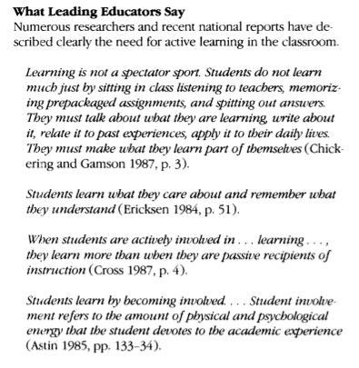
Active Learning:
Premises and Misnomers 1985-2015
Active learning techniques are privileged as conducive to “higher order” thinking and learning ---and therefore can be directly linked to student success---
Active learning is something that takes place in the classroom
Online instruction thus necessarily becomes the place of passive, lower order learning
A Brief History of Online Education
1985 Nova Southeastern University offering accredited graduate degrees through online courses.
1989 The University of Phoenix online campus launches. For the first time, a private university offered the entire curriculum of bachelor's and master's degrees online. Online education was accessible to the masses.
1992 Michigan State University develops the Computer Assisted Personalized Approach (CAPA).
1994 CALCampus offers real-time education in its completely online school.
Source: worldwidelearn.com
-John Bonwell, Active Learning: Creating Excitement in the Classroom (1991)
Ben Spanbock. UCB College Writing Programs, 2015

Slide 12
Part 2: Interventions
Critical Questions:
1) What are the respective strengths of F2F and online communication?
2) What is the intended educational purpose of my blending?
3) Is my approach to blending built to maximize student success?
Ben Spanbock. UCB College Writing Programs, 2015

Slide 13
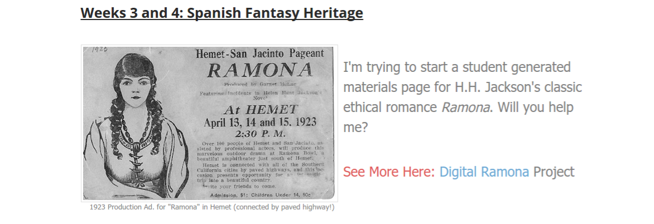
Part 2: Interventions
Making Inter(active) Project Pages:
Ben Spanbock. UCB College Writing Programs, 2015

Slide 14
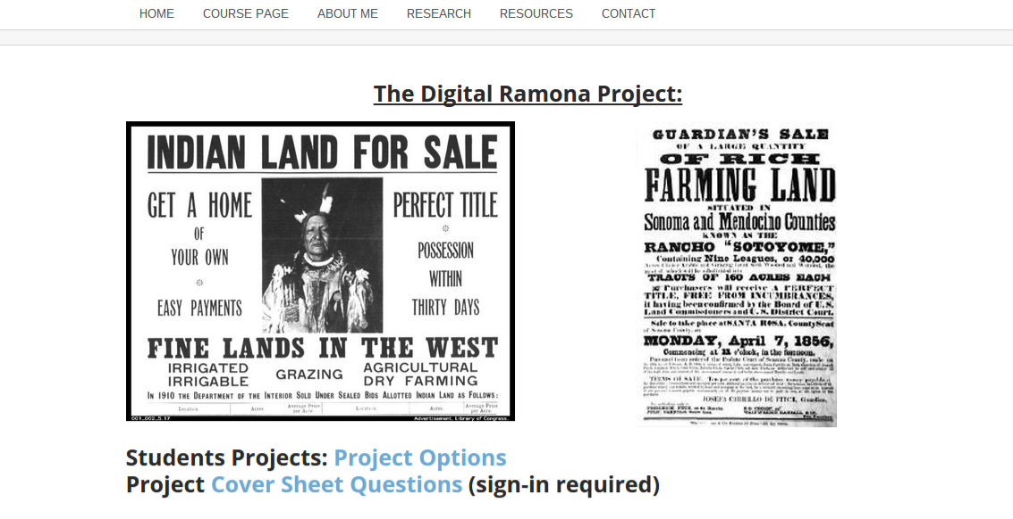
Part 2: Interventions
Making Inter(active) Project Pages:
Ben Spanbock. UCB College Writing Programs, 2015

Slide 15
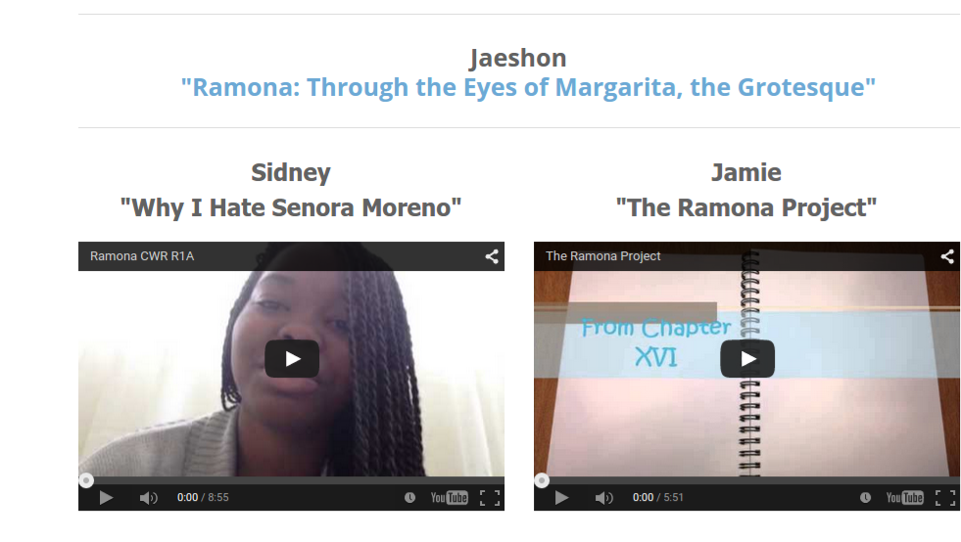
Part 2: Interventions
Making Inter(active) Project Pages:
Ben Spanbock. UCB College Writing Programs, 2015

Slide 16
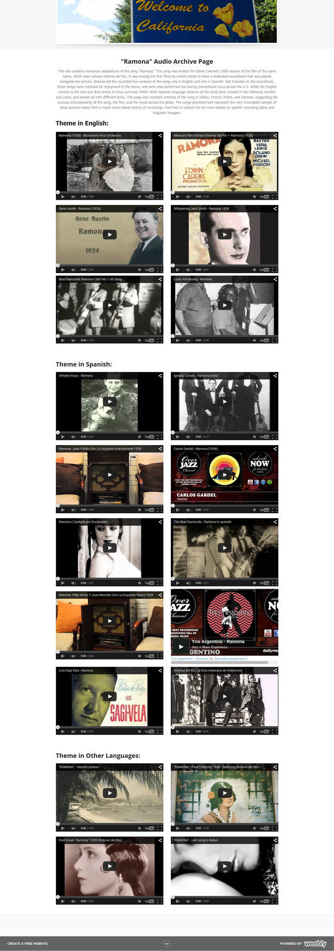
Part 2: Interventions
Making Inter(active) Project Pages:
Ben Spanbock. UCB College Writing Programs, 2015

Slide 17
Critical Questions: Is the magic in the mix yet?
1) What are the respective strengths of F2F and online communication respectively?
Online instruction has the potential to be active!
2) What is the intended educational purpose of my blending?
Foster creativity and highlight achievement
Give students increased ownership over class content
3) Is my approach to blending built to maximize student success?
Engage with critical questions related to composition, such as audience, style, voice, etc.
Ben Spanbock. UCB College Writing Programs, 2015

Slide 18
Multimodal Composition: Shared Challenges
When students are given access to pedagogical spaces and learning opportunities for experimenting with different ways to make meaning, they are drawing on the stuff of everyday social interaction to rethink the shape of written academic knowledge. But this process of rethinking what is possible in academic writing is not without its challenges and failures.
Tracey Bowen and Carl Whithaus,“What Else Is Possible”:
Multimodal Composing and Genre in the Teaching of Writing.
Ben Spanbock. UCB College Writing Programs, 2015

Slide 19
Critical Questions:
1) What are the respective strengths of F2F and online communication respectively?
2) What is the intended educational purpose of my blending?
3) Is my approach to blending built to maximize student success?
4) What role should the instructor play in developing (?) blended course content?
5) What might active learning online look like?
Ben Spanbock. UCB College Writing Programs, 2015

Slide 20
Part 3: Beyond Curating
Decentering the instructor using the social blogging site tumblr.:
Engage in mutlimodal writing to develop a “digital identity” related to the course
Create, receive, and share course content across a sustained, project based learning environment
Instructor positioned as a participant in the learning process
Ben Spanbock. UCB College Writing Programs, 2015

Slide 32
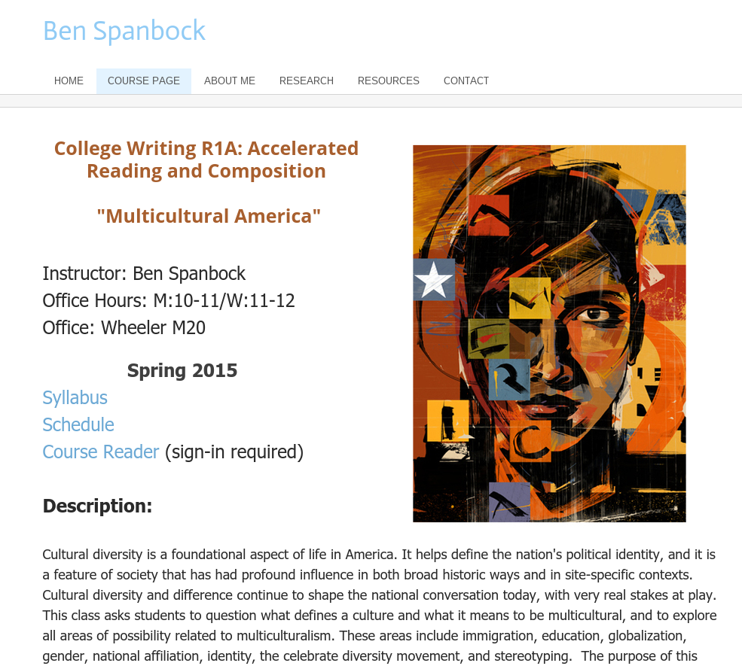
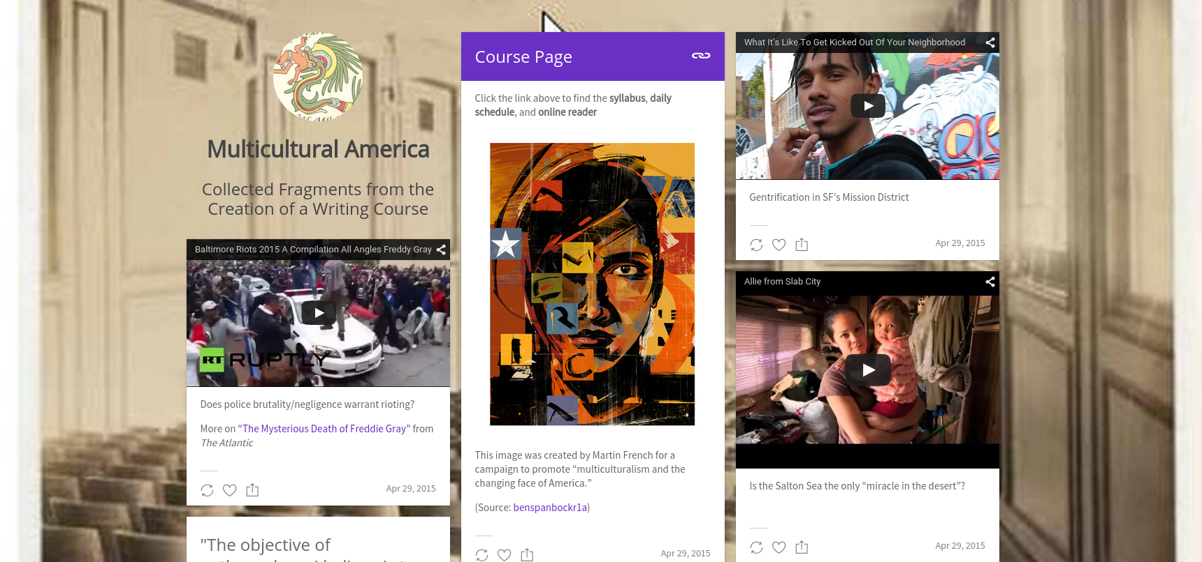
From Start to Present:
Ben Spanbock. UCB College Writing Programs, 2015

Slide 33
Consulted Works:
Baepler, Paul, J.D. Walker, and Michelle Driessen. “It's Not About Seat Time: Blending, Flipping,and Efficiency in Active Learning Classrooms.” Computers & Education 78 (2014) : 227–236. Print.
Brame, Cynthia. “Flipping the Classroom.” Vanderbilt University Center for Teaching and Learning. Vanderbilt University. http://cft.vanderbilt.edu/guides-sub-pages/flipping-the-classroom. 5.10.2015. Web.
Bonwell, Charles. Active Learning: Creating Excitement in the Classroom. San Francisco: Jossey-Bass, 1991. Print.
Bowen, Tracey, and Carl Whithaus. “‘What Else Is Possible’: Multimodal Composing and Genre in the Teaching of Writing.” Multimodal Literacies and Emerging Genres. Bowen and Whithaus, Eds. Pittsburgh, PA: University of Pittsburgh Press, 2013. Print.
Garrison, D. Randy and Norman D. Vaughn. Blended Learning in Higher Education: Framework, Principles, and Guidelines. San Francisco: Jossey-Bass, 2008. Print.
Kim, Min Kyu et al. “The Experience of Three Flipped Classrooms in an Urban University: An Exploration of Design Principles.” Internet and Higher Education 22 (2014) : 37-50. Print.
Masie, Elliott. “The Blended Learning Imperative.” The Handbook of Blended Learning : Global Perspectives, Local Designs. Ed. Bonk and Graham. San Francisco : Pfeiffer, 2006. Print.
Miller, Suzanne M. and Mary B. McVee. Multimodal Composing in Classrooms : Learning and Teaching for the Digital World. New York: Routledge, 2012. Print.

